Slide 1
1. Preparation Meeting Young Talents Day 2017
14:30 Welcome
Introduction of the EEF, ICEL and the Young Talents Day
Participation in the Young Talents Day – benefits for pupils
“The critical environmental situation in my home country”
– short lectures of UWC students
15:10 Short break
Introduction of different environmental fields of work
Introduction of the online platform EnviroNetwork.eu
16:25 Closing remarks

Slide 2
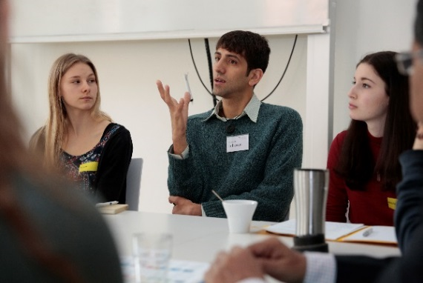
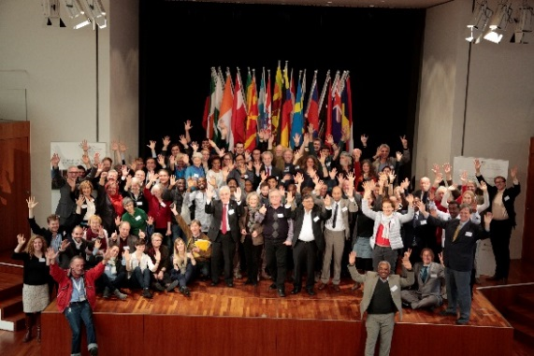
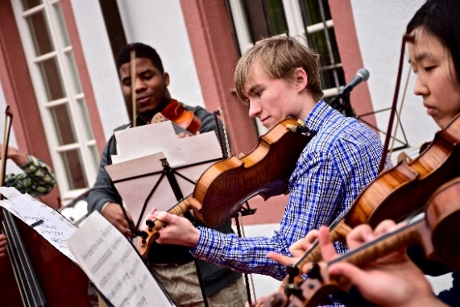
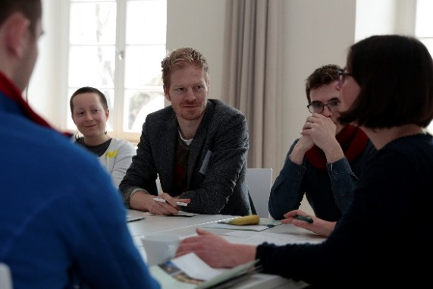
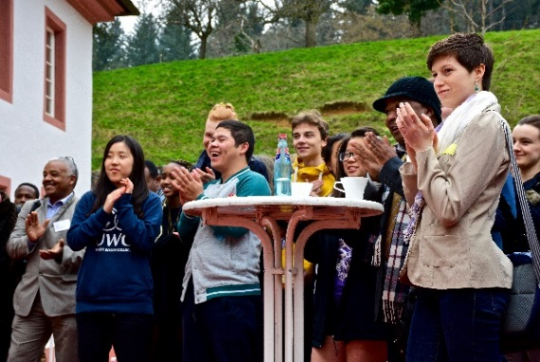
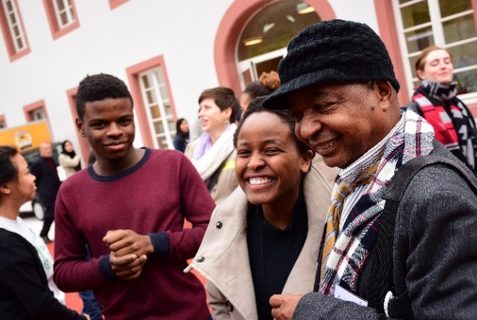
REVIEW 5th ICEL

Slide 3
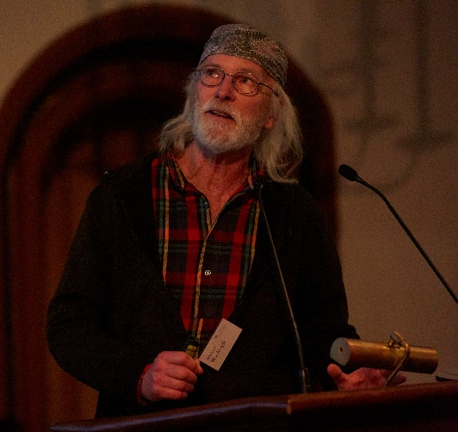
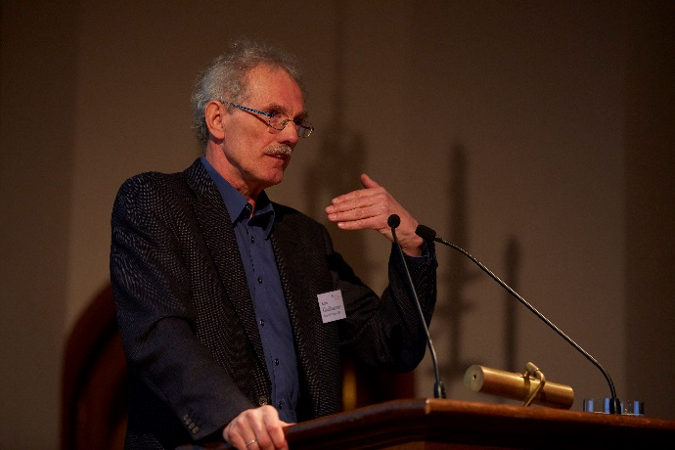
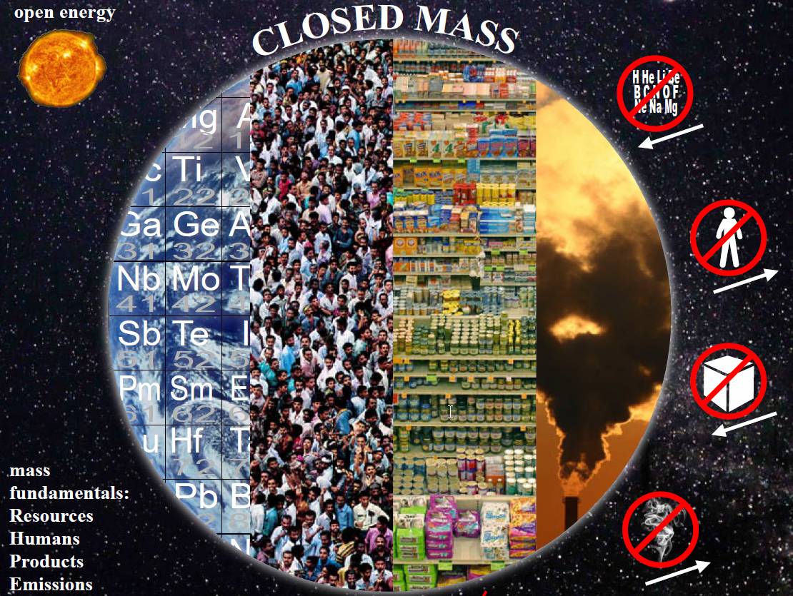
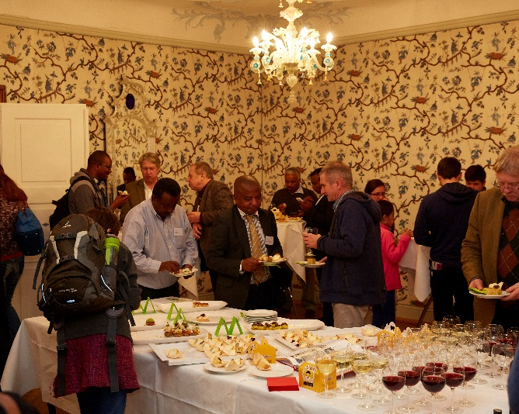
Thursday 10 March
Opening Ceremony and Welcome Reception
Notes:
. During the opening ceremony Prof. Griesshammer and Michael Wadleigh suggested simple measures on how to combat climate change and how to act more responsible concerning the limited resources on our planet. After the speeches all visitors were invited to join the welcome reception with local and organic finger food. In total, around 120 People attended the opening ceremony.

Slide 4
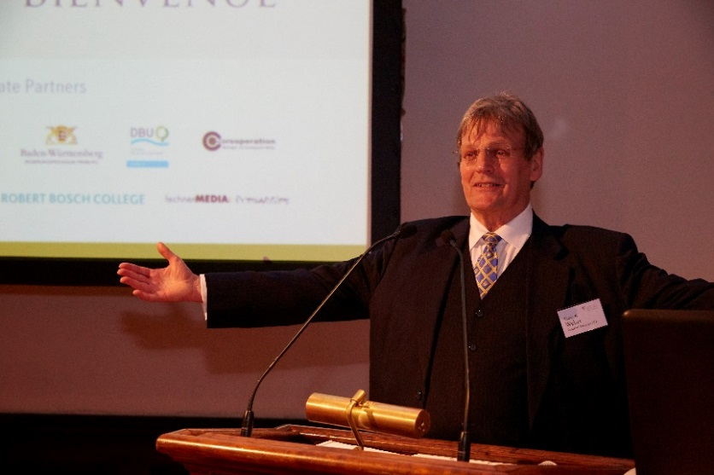
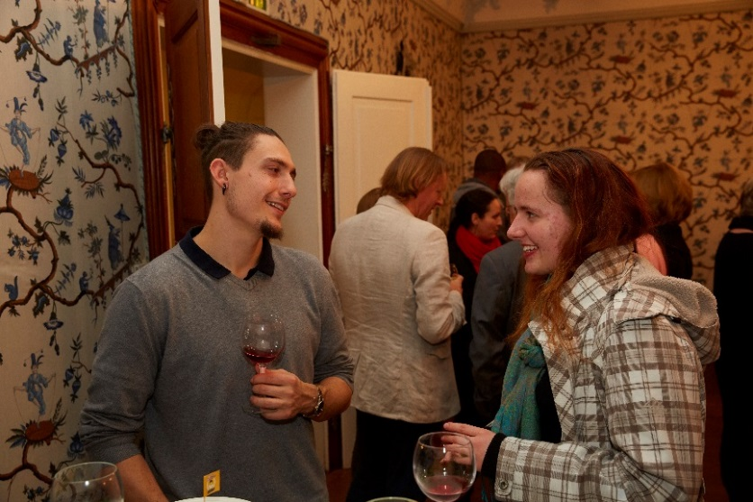
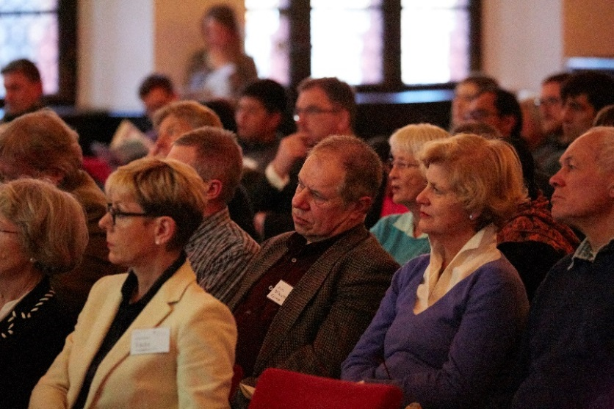
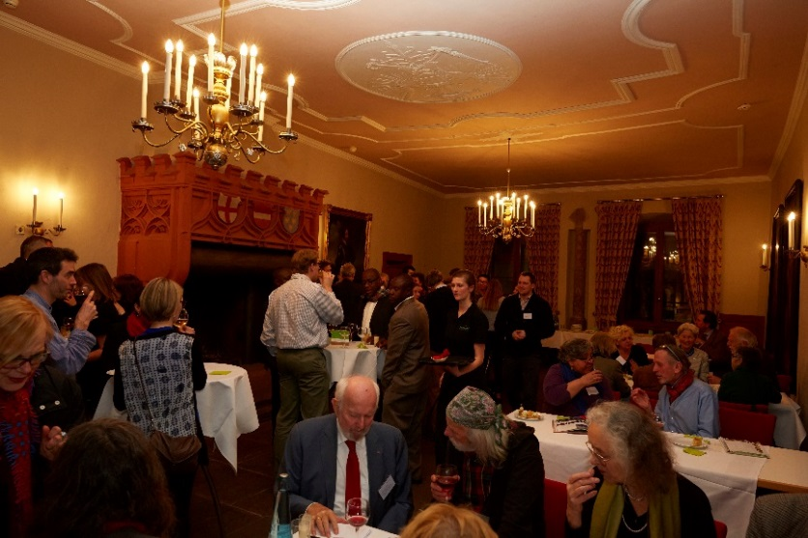
Thursday 10 March
Opening Ceremony and Welcome Reception

Slide 5
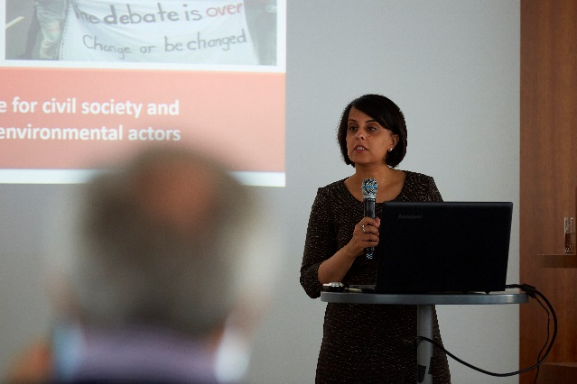
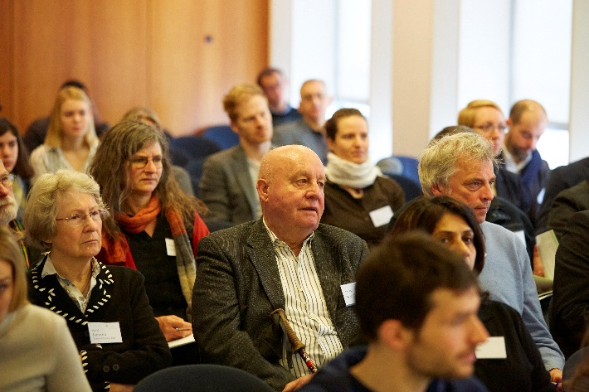
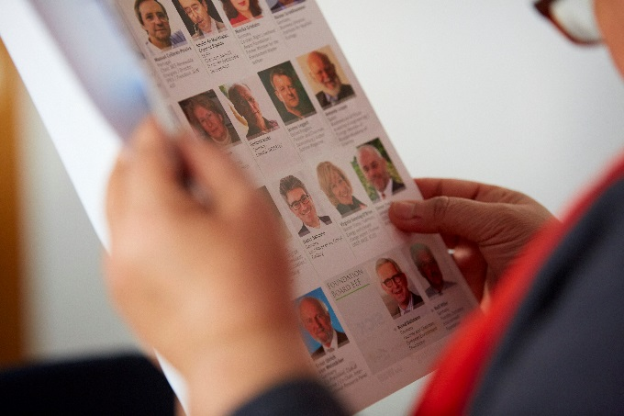
Friday 11 March
Laureates´ Symposium – learning from others
Master Classes
Economy for the common good (Gemeinwohlökonomie)
The growing push-back against NGOs and civil society
Running a succesful campaign
Fundraising
Laureates´Presentations
Biodiversity
Social engagement
Climate change
Renewable energy
Disarmament
UN SDG´s

Slide 6
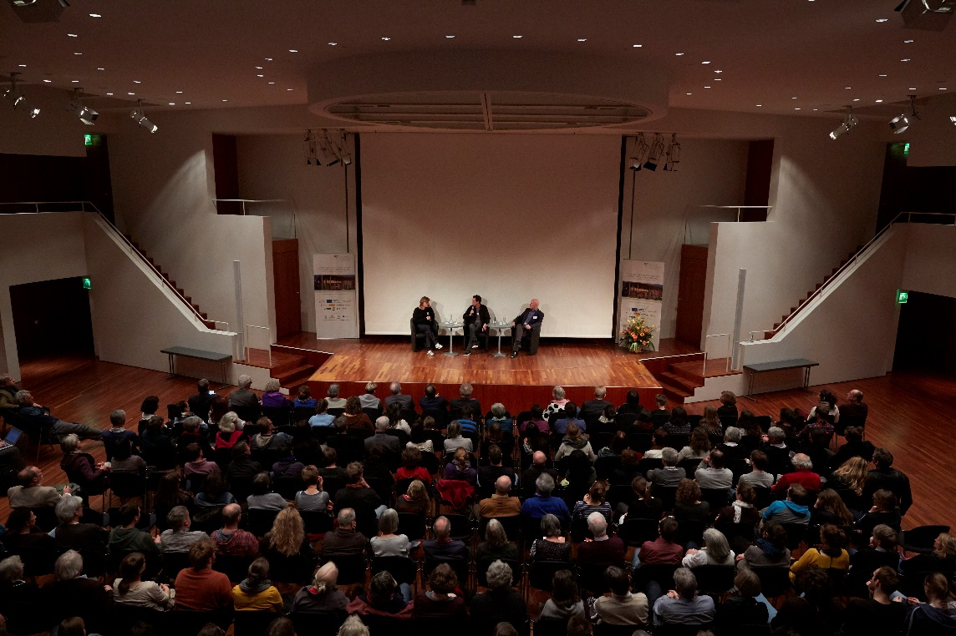
Friday 11 March
Discussion: Paris Climate Agreement & Beyond – Global Environmental Laureates and their Contribution to the 1,5 °C Goal
Evening Event: AGROKALYPSE – movie screening

Slide 7
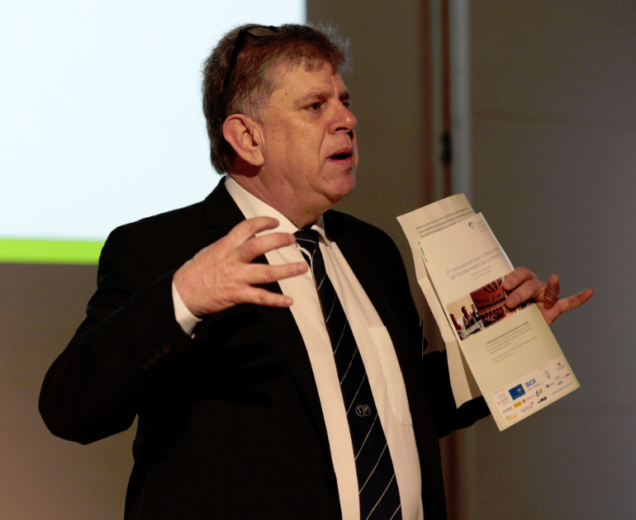
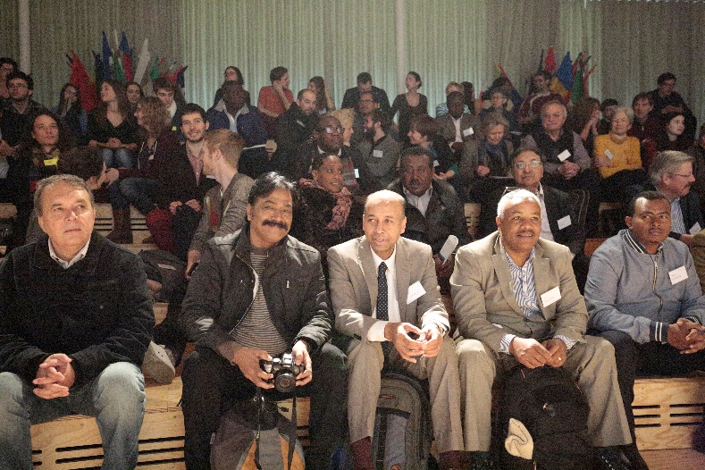
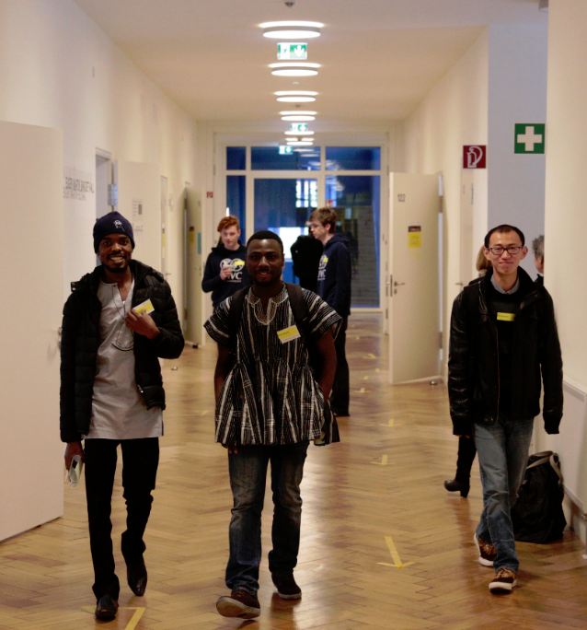
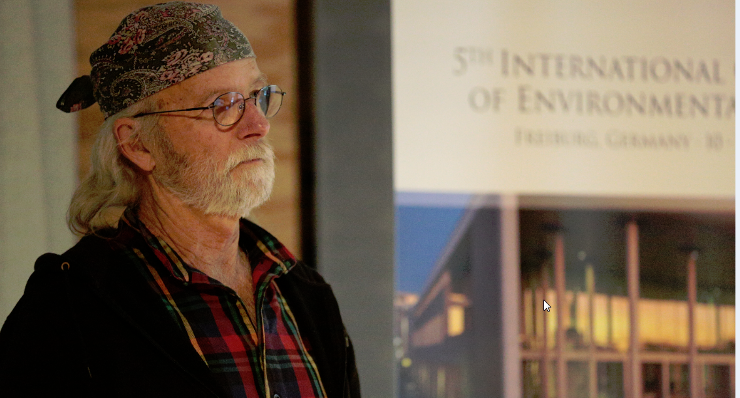
Saturday 12 March
Young Talents Day

Slide 8
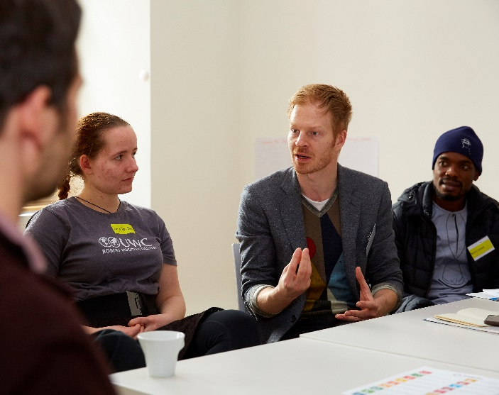
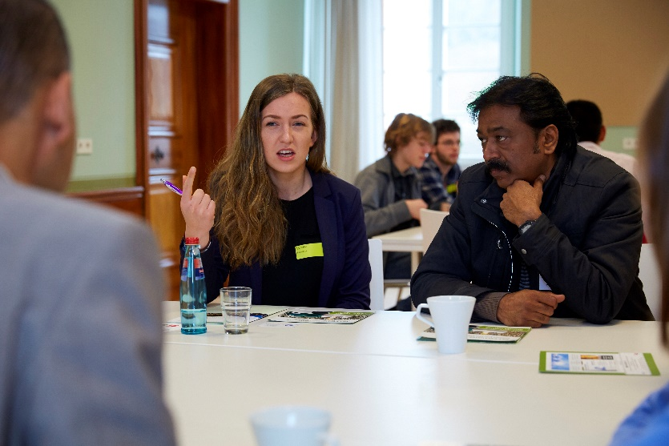
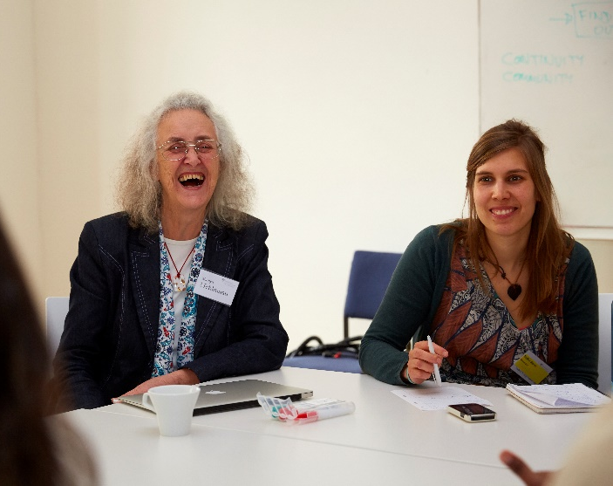
Saturday 12 March
Young Talents Day – Round Table Discussions

Slide 9
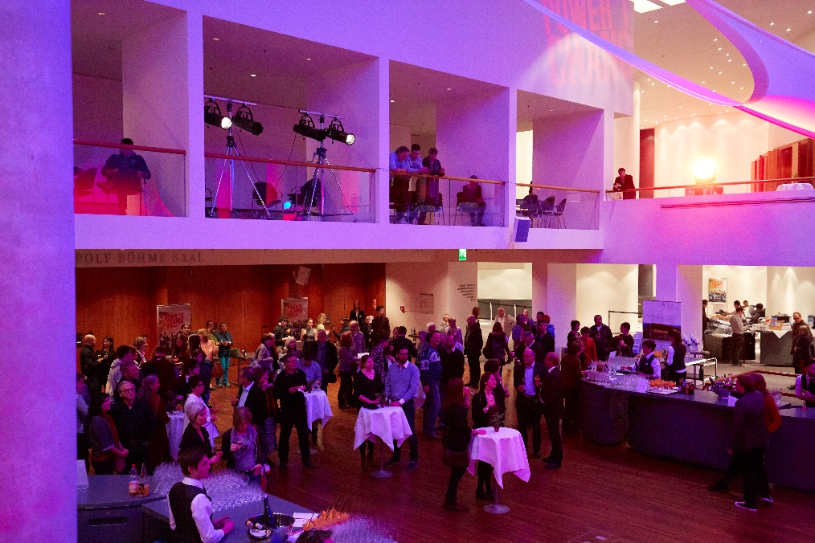
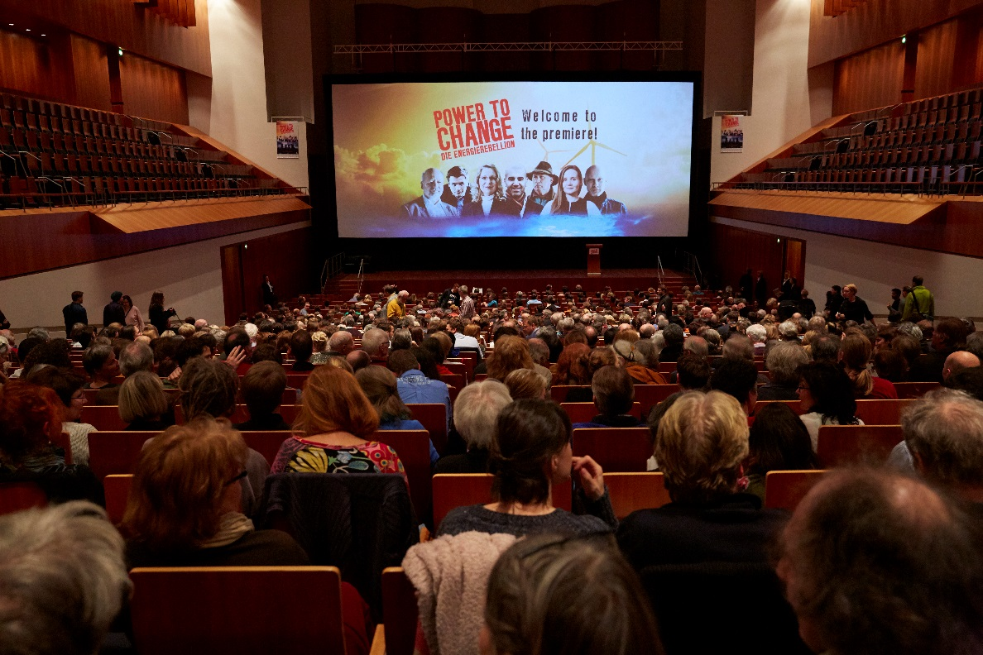
Saturday 12 March
POWER TO CHANGE – exlusive movie premiere

Slide 10
