Slide 1
Introduction to Topics and Laureates

Slide 2
 | Education / Communi- cations | Policy and Law | Social Engage- ment | Science & Techno-logies | Private Sector
Biodiversity & Nature Conservation
Sustainable Land Management
Climate Change
Sustainable Energy
Four general topic areas

Slide 3
 | Education / Communi- cations | Policy and Law | Social Engage- ment | Science & Techno-logies | Private Sector
Biodiversity & Nature Conservation
Sustainable Land Management
Climate Change
Sustainable Energy
Five tools to use in the topic areas

Slide 4
 | Education / Communi- cations | Policy and Law | Social Engage- ment | Science & Techno-logies | Private Sector
Biodiversity & Nature Conservation
Sustainable Land Management
Climate Change
Sustainable Energy

Slide 5
Biodiversity & Nature Conservation

Slide 6
Biodiversity & Nature Conservation
Biodiversity: number of species, not: number of individual animals
150-200 species of plant, insect, bird and mammal become extinct every day

Slide 7
Biodiversity & Nature Conservation
Important causes are pollution, illegal hunting and habitat destruction
Establishing nature reserves is one way to protect biodiversity

Slide 8
Sustainable Land Management

Slide 9
Sustainable Land Management
83% of the world’s land area is directly influenced by human activities such as farming or mining
unsustainable land management practices destroy or degrade the land

Slide 10
Sustainable Land Management
every year an area four times the size of Baden-Württemberg is lost due to desertification
sustainable land management includes planting trees and protecting the soil

Slide 11
Climate Change

Slide 12
Climate Change
Human emissions of greenhouse gases cause an increase in global temperatures
Greenhouse gases are produced by activities such as burning fossil fuels and cutting down trees

Slide 13
Climate Change
It causes rising sea levels, desertification, droughts and more frequent extreme weather events
Poor people and developing countries will be most affected

Slide 14
Sustainable Energy

Slide 15
Sustainable Energy
Fossil fuels – coal, oil and gas – provide 80% of the energy globally
Burning fossil fuels causes 65% of all greenhouse gas emissions
Air pollution killed 5.5 million people in 2016

Slide 16
Climate Change
Renewable sources – e.g. wind and solar – currently provide 13% of the energy globally
solar energy is now cheaper than coal in many parts of the world

Slide 17
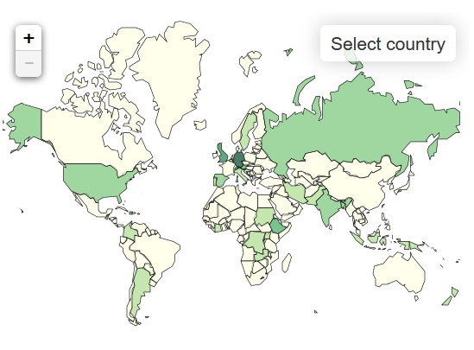
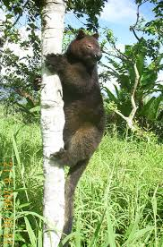
Environmental Laureates –
Biodiversity & Conservation
Mathew Akon
Papua New Guinea
Tenkile Conservation Alliance
Protecting endangered species as a government liaison officer

Slide 18
 | Education / Communi- cations | Policy and Law | Social Engage- ment | Science & Techno-logies | Private Sector
Biodiversity & Nature Conservation
Sustainable Land Management
Climate Change
Sustainable Energy

Slide 19
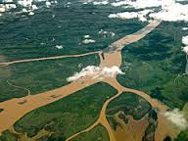
Environmental Laureates –
Biodiversity & Conservation
Luciano Iribarren
Argentina
University of Buenos Aires
Scientist & educator coordinating outreach programs for wetland restoration

Slide 20
 | Education / Communi- cations | Policy and Law | Social Engage- ment | Science & Techno-logies | Private Sector
Biodiversity & Nature Conservation
Sustainable Land Management
Climate Change
Sustainable Energy

Slide 21
Environmental Laureates – Climate Change
Balgis O. Elasha
Sudan
African Development Bank
Provides advice to governments about impacts of climate change

Slide 22
 | Education / Communi- cations | Policy and Law | Social Engage- ment | Science & Techno-logies | Private Sector
Biodiversity & Nature Conservation
Sustainable Land Management
Climate Change
Sustainable Energy

Slide 23
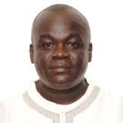
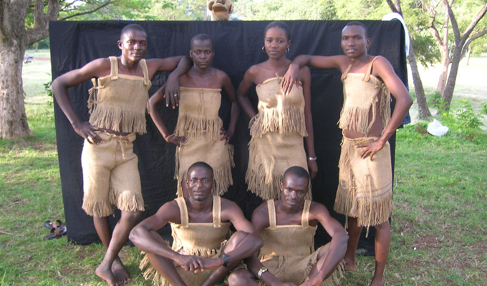
Environmental Laureates – Climate Change
Leonard Akwany
Kenya
Ecofinder Kenya
Coordinates environmental entrepreneurship for sustainable communities

Slide 24
 | Education / Communi- cations | Policy and Law | Social Engage- ment | Science & Techno-logies | Private Sector
Biodiversity & Nature Conservation
Sustainable Land Management
Climate Change
Sustainable Energy

