Slide 1









EFFORTS ON LONG-TERM REDUCTION OF CATASTROPHIC WILDFIRES RISKS IN THE CHERNOBYL EXCLUSION ZONE:
AN EXAMPLE OF INTEGRATION OF SCIENCE, NETWORKING AND AWARENESS RISING TOWARDS ADDRESSING A CREEPING AND LARGELY UNOBSERVED HUMANITARIAN AND ENVIRONMENTAL DISASTER (2005-2017)
Global Fire Monitoring Center | Regional Eastern European Fire Monitoring Center | National University of Life and Environmental Sciences of Ukraine
6th International Convention of Environmental Laureates, Freiburg, 9-12 March 2017
Sergiy Zibtsev, Johann G. Goldammer
Regional Eastern European Fire Monitoring Center, Kyiv, Ukraine
Global Fire Monitoring Center (GFMC), Freiburg, Germany
6th International Convention of Environmental Laureates, Freiburg, 9-12 March 2017

Slide 2

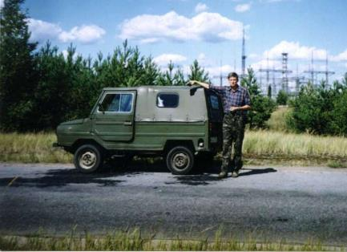
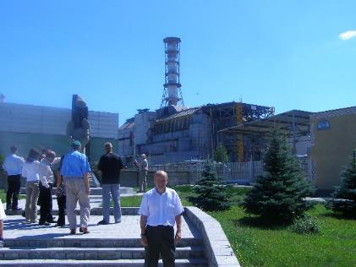
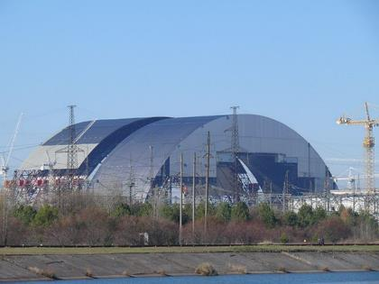
Integration of science, networking and awareness can help to radically improve environment in regions of ecological crisis
2003 2007 2017

Slide 3
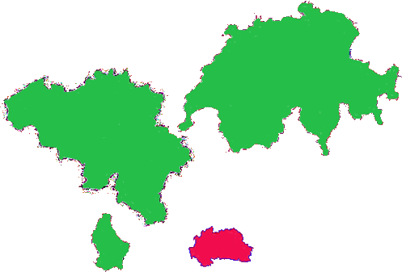
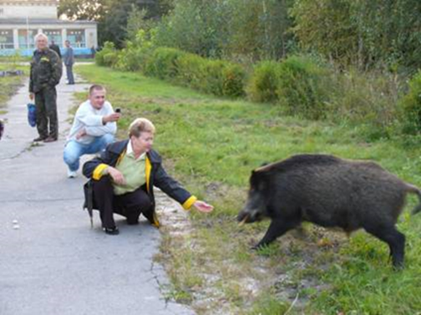
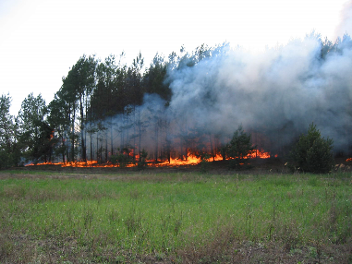
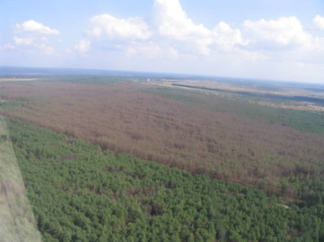
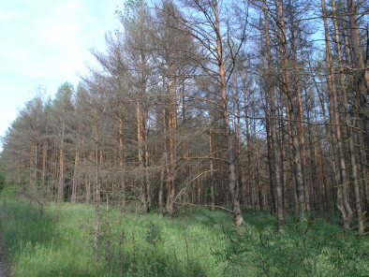
The Chernobyl Exclusion Zone
Люксембург
2,6 тыс. км²
Territory – 2 600 км²
Border – 439 км
No population
Chernobyl NPP, radioactive waste fac.
Personnel – around 10 000 persons
150 000 ha of high prone forests
Luxemburg Exclusion Zone
2 600 км² 2 600 км²

Slide 4
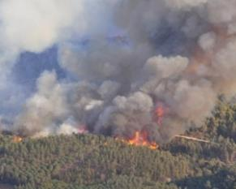
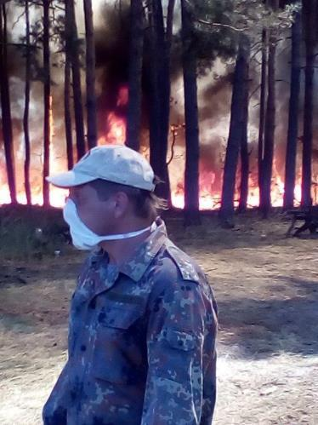
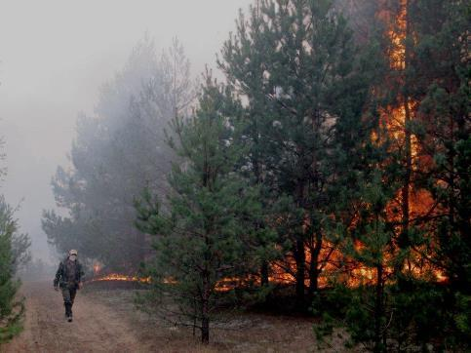
Problem statement:
Large forest fires in terrains contaminated by Cs-137 / Sr-90 (total area more than 500 000 ha) result in secondary contamination of environment and threaten human health and security

Slide 5
Needs:
- Research to understand scale, dynamic and consequences of radioactive fires
- Technical solutions to prevent and suppress fires
- Legislation, regulations and policies
- Capacity building
- Training to enhance local fire management knowledge and skills
Barriers:
- Lack of funding
- Limited attention by government and international organizations

Slide 6
Step 1. Research, publications, conferences (2005-2016)
National University of Life and Environmental Sciences of Ukraine
Global Fire Monitoring Center, Freiburg, Germany
Yale University, USA
Canadian Fire Research Center
U.S. Forest Service
Norwegian Institute of Atmospheric Research, Norway
Academy of Science of France
Reporting at international conferences (EGU, IUFRO, International Wildland Fire Conferences)

Slide 7

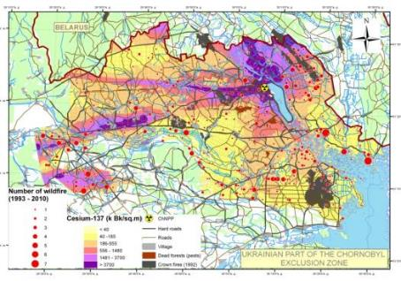
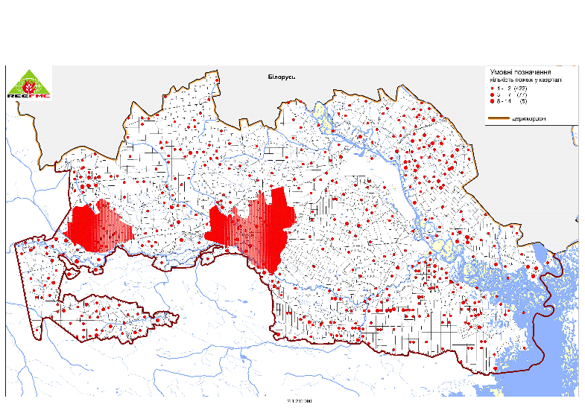
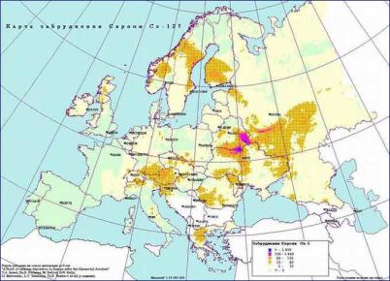
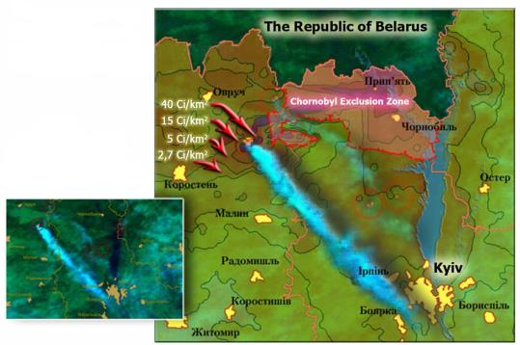
Disaster of the Chernobyl Nuclear Power Plant (1986), Exclusion Zone and fires

Slide 8
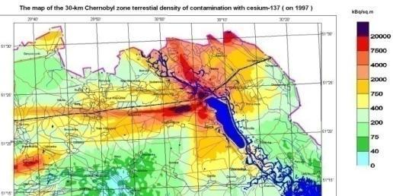
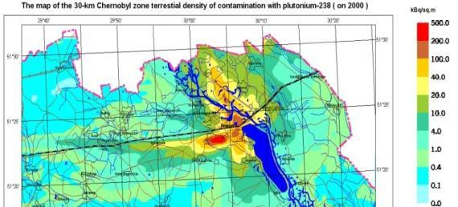
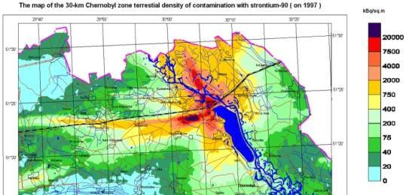
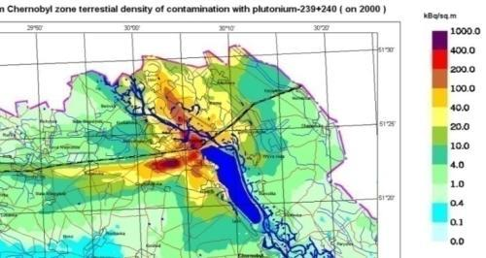
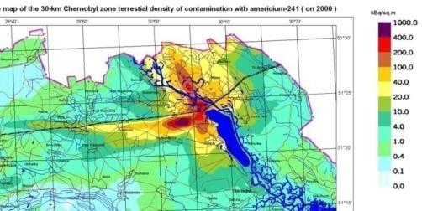
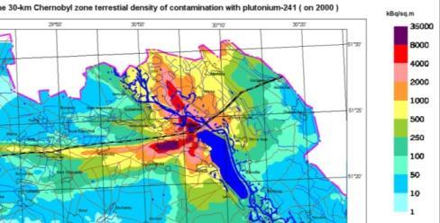
Contamination of the Chernobyl exclusion zone
¹³⁷Cs
30 years
²³⁸Pu
87.7 y
⁹⁰Sr
29 years
²³⁹⁻²⁴⁰Pu
24 065 y
6 537 y
²⁴¹Am
432 y.
²⁴¹Pu
14.4 y
Source: www.uiar.org.ua
Notes:
Стронций-90 29,12 лет Цезий-137 30,0 лет
Плутоний-238 87,74 лет
Плутоний-240 6 537 лет

Slide 9
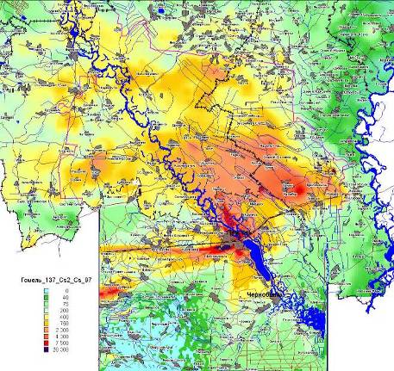
Chernobyl Exclusion Zone
Ukraine, 26 April 1986
Fukushima 1
Japan, 11 March 2011
¹³⁷Cs, kBq/m²
IRSN, 2011
Notes:
The territories contaminated with cesium isotopes in the near 30-km zone after the Chernobyl accident and in Japan in 2011 are comparable.
The number of Japanese people living in the most contaminated areas outside the initial 20-km radius evacuation zone around the Fukushima plant (874 km² with ¹³⁴⁺¹³⁷Cs deposits higher than 600,000 Bq/m²) was estimated to 70,000 people including 9,500 children of 0-14 years in age.
This significant number reaches about 26% of that of Chernobyl (270,000 people) for a surface area only 8.5% of that of Chernobyl (10,300 km²).
IRSN,2011

Slide 10


Doses to the firefighters (conservative estimate) from 1-hr exposure in the fire area
 | Maximum airborne concentration, Bq m⁻³, in the site |  |  | Dose type | Dose, μSv, in the site
 | #1 | #2 | #3 |  | #1 | #2 | #3
¹³⁷Cs | 5 | 1 | 0.27 | External from the cloud | 6.9⋅10⁻⁴ | 1.4⋅10⁻⁴ | 3.7·10⁻⁵
 |  |  |  | Inhalation | 6⋅10⁻² | 1.2⋅10⁻² | 3.2·10⁻³
⁹⁰Sr | 3 | 0.5 | 0.33 | External from the cloud | 10⁻⁴ | 1.7⋅10⁻⁵ | 1.1·10⁻⁵
 |  |  |  | Inhalation | 0.24 | 4.1⋅10⁻² | 2.6·10⁻²
²³⁸Pu | 3.4⋅10⁻³ | 2.5⋅10⁻⁴ | 4.6·10⁻⁴ | Inhalation | 7.1 | 0.53 | 1
²³⁹⁺²⁴⁰Pu | 6.7⋅10⁻³ | 5.1⋅10⁻⁴ | 1.1·10⁻³ | Inhalation | 17 | 1.3 | 2.8
External irradiation from soil and vegetation |  |  |  |  | 16 | 10 | 4.2
Total dose |  |  |  |  | 40 | 12 | 8
Reduce Risk of Disaster from Catastrophic Wildfires in the Chernobyl Irradiated Forests
Kyiv 26-27July 2007

Slide 11
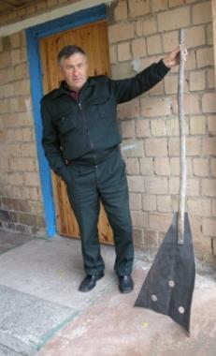
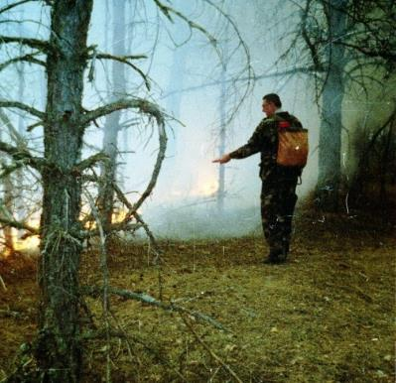
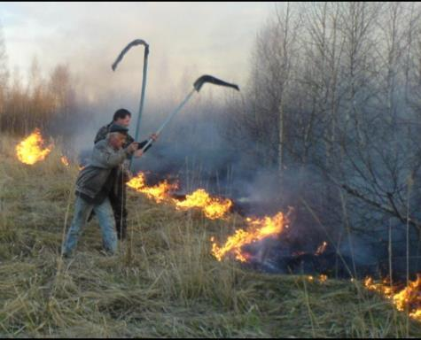
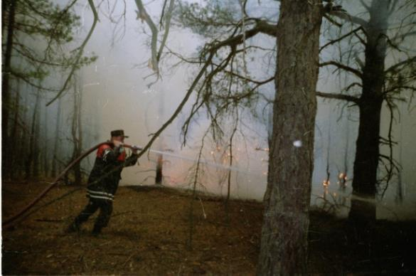
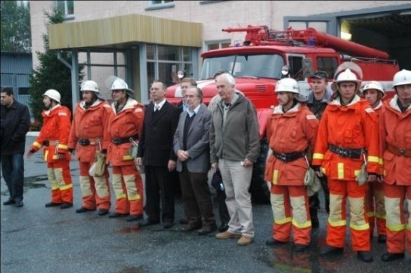
Fire Fighting in the Chernobyl Exclusion Zone

Slide 12
Step 2. Networking to bring / exchange knowledge / funding / technology to the region and capacity building

Slide 13


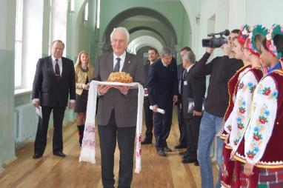
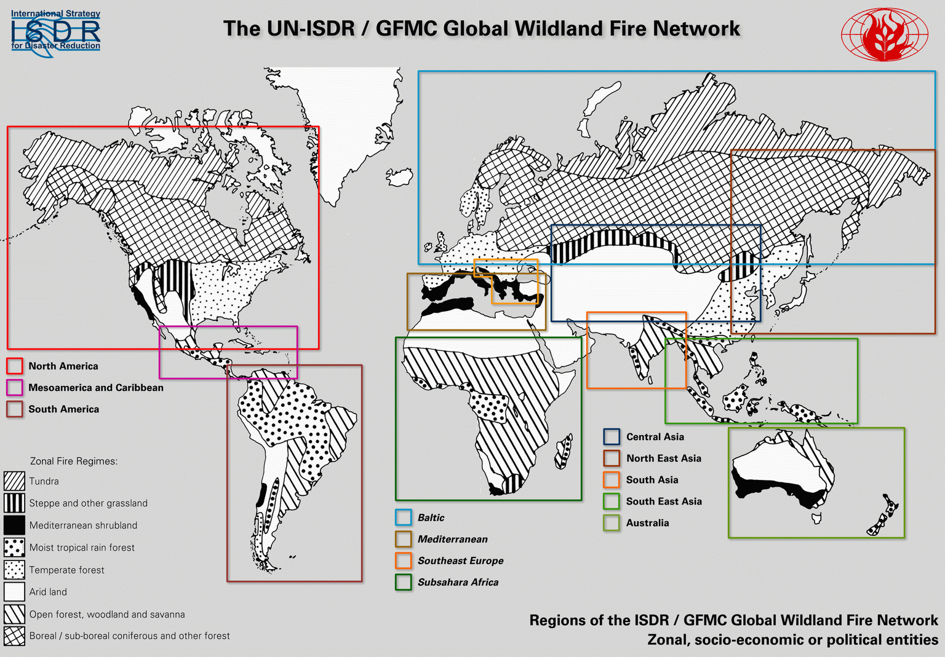
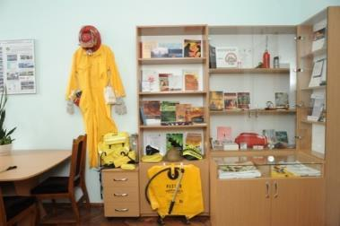
Regional networking in South-East and Eastern Europe has been initiated in 2002-2007 under GFMC leadership, Freiburg, Germany
REEFMC inauguration as a regional network center of GFMC, Kiev, 3 March 2013

Slide 14
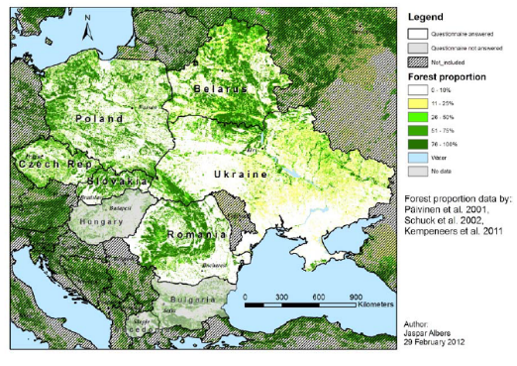
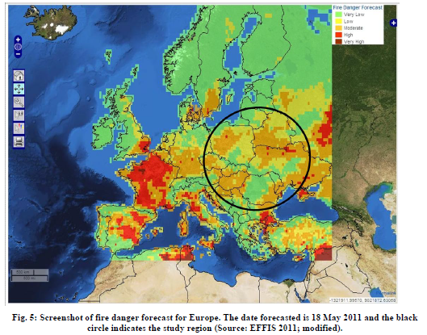
Eastern European Region – Scope of REEFMC
Source: Jaspar Albers, 2012
6th International Convention of Environmental Laureates, Freiburg, 9-12 March 2017

Slide 15

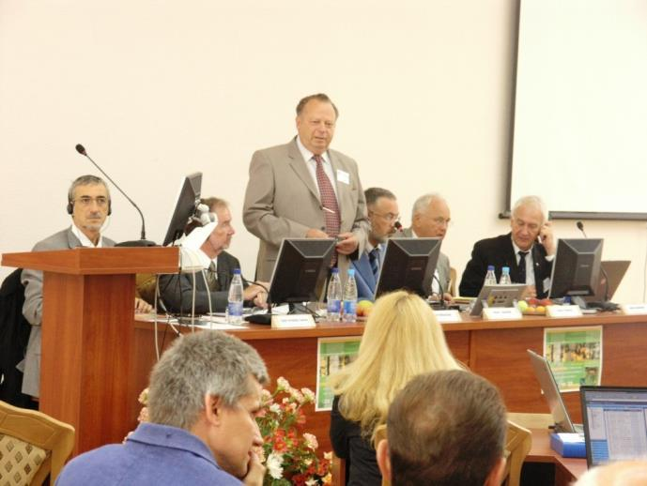
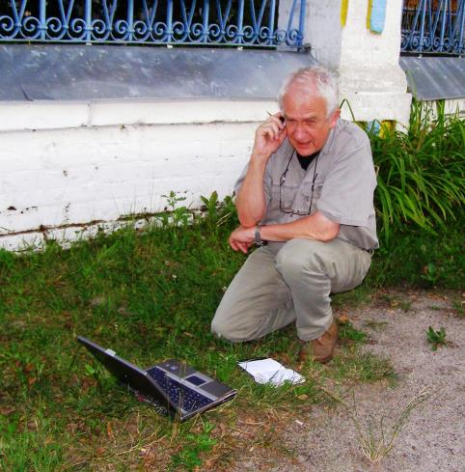
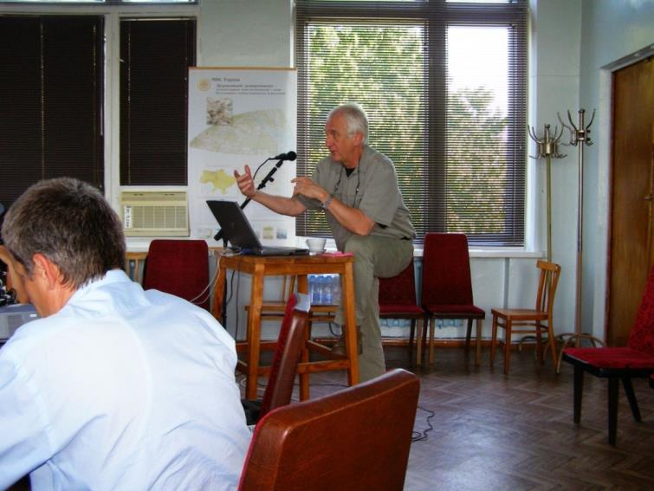
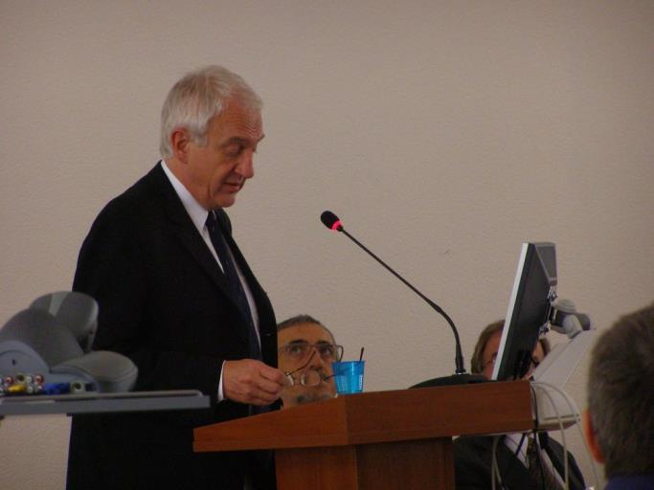
Chernobyl Fire Conference and field trip
Chernobyl City, July 2007

Slide 16

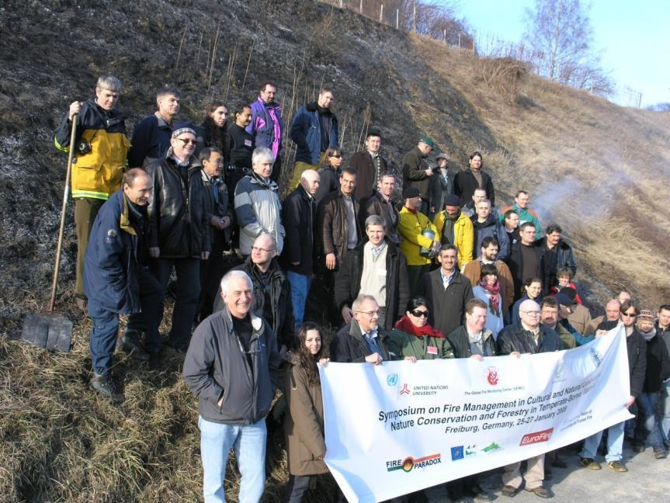
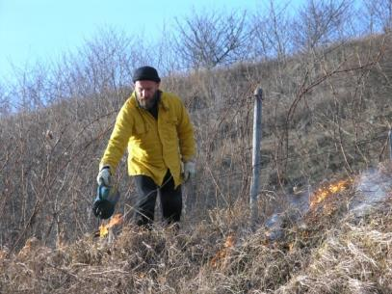
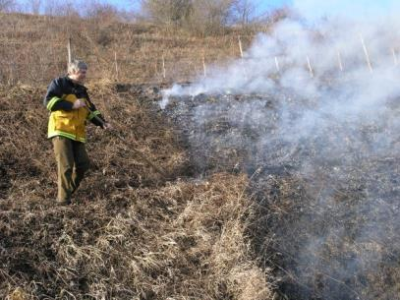
GFMC global network team doing prescribe burning in Freiburg and Upper Rhine Valley, Germany, January 2008

Slide 17
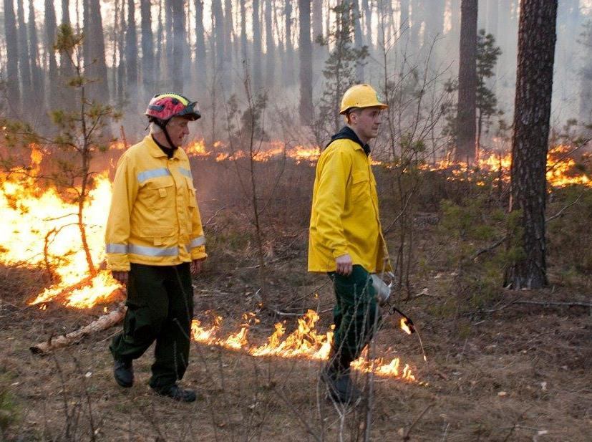
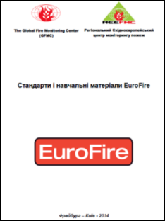
Prescribed burning in pine forests in Ukraine
Boyarka (2015)

Slide 18

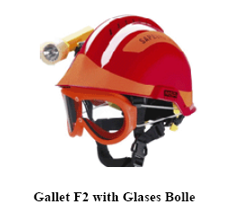

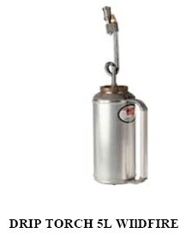
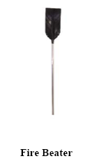
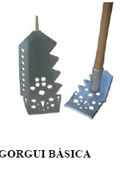
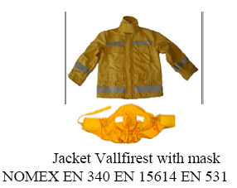
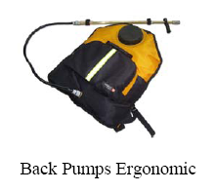
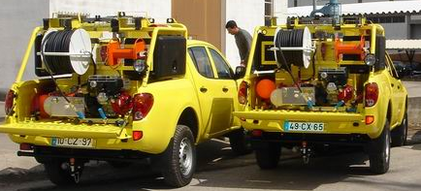
Increasing technical capacity, skills and individual safety of fire fighters in the Chernobyl Exclusion Zone

Slide 19
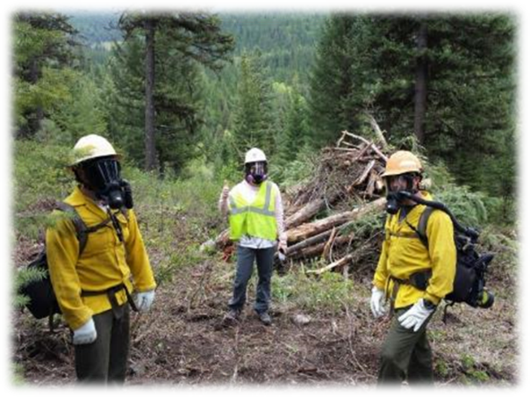
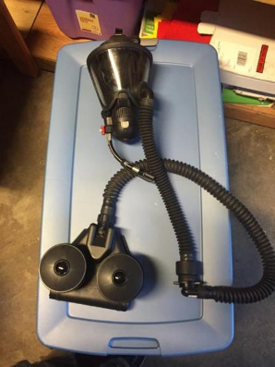
Improving personal safety of fire fighters via individual protection means, better coordination, early detection safe strategy and tactics of fire suppression
Use of active filters M7 Firehawk in Libby area contaminated by asbestos, Montana, USA

Slide 20





Automatic Wildfire Detection System (350 000 US$)
Emergency Coordination Center
Tower 1
Tower 2

Slide 21
Step 3. Awareness rising to implement actions needed
Decisions of authorities of Ukraine: President, Government, Parliament
Support of global and regional International Organizations (UNISDR, UNECE, UNEP, GEF, CoE, OSCE and GFMC)
Support of governments: USA, EU

Slide 22
Conclusions
At the moment four donors (GEF, US Forest Service, OSCE, CoE) ready to provide around 500 000 US$ for the implementation of integrated fire management
Fire policy, strategy under development
Early warning system based on remote sensing data
“No human” automatic 24/7 fire detection system developed and ready for implementation
Decision support system for prevention and safe fire suppression developed

Slide 23

Thanks for Your Attention!
More information:
Regional European Fire Monitoring Center
www.nubip.edu.ua/en/reefmc
Global Fire Monitoring Center
http://www.fire.uni-freiburg.de/
http://www.fire.uni-freiburg.de/GlobalNetworks/SEEurope/SEEurope_1_radio.html

